Slide 1
Supporting Justice Involved Victim Survivors of Domestic Violence
Brittany Anderson & Laurissa Wredberg
Victim Services & Restorative Justice Unit

Slide 2
Agenda
Brief overview of MN Department of Corrections
Brief overview of services to those impacted by harm

Slide 3
Key takeaways
Creative solutions – think outside the box, flexible, brave
Reach out if:
You need a liaison with the facility – utilize VSRJ staff to assist in access and connecting you with the correct person.
You or the victim/survivor has questions
DOC doesn’t know what we don’t know in terms of supporting a particular individual, we want to collaborate and develop relationships and services that meet the complex needs of victim survivors who experience incarceration
Know that we may contact you to:
Provide services to a justice involved individual needing support and resources

Slide 4
Key takeaways
Advocacy support is needed throughout an individual’s incarceration and supervision period
Regular check-ins
Especially at 30, 60, 90, and a year
Anniversary dates
If you are aware of a transition within the system (supervision, facility transfers, treatment, etc.)

Slide 5
Overview of MN DOC
Incarcerated population: 7,200 (approx.)
Juveniles: Red Wing (60)
Women: Shakopee (394)
Men: 6,740 (approx.)
Level 2 Togo (72), Willow River (113)
Level 2 & 3 Faribault (1697)
Level 2 & 3 Lino Lakes (906)
Level 3 Moose Lake (741)
Level 4 St. Cloud (Intake) (726)
Level 2 & 4 Stillwater (1279)
Level 4 Rush City (820)
Level 5 Oak Park Heights (332)
DOC community supervision: 104,000 (approx.)

Slide 6
A Sample of DOC Crime Types
Crime type (sample) | Total number of current sentences (12,241) | % of all current sentences
Homicide | 1768 | 14%
Criminal Sexual Conduct | 2043 | 16%
Assault – domestic | 828 | 6%
Assault | 1133 | 9%
Robbery | 658 | 5%
Harassment/Stalking | 79 | .06%
Weapons | 977 | 7%
Drugs | 1971 | 16%
Services are provided to all victims/survivors of those under DOC jurisdiction, no matter the type of crime.

Slide 7
What do we do?
Victim Services
Statutory Obligations:
PREA advocacy
Life Sentence Review advocacy
POR/Community Notification advocacy/ECRC Victim Services Representative
Post-Conviction Advocacy:
Safety planning
Reunification/Reentry
Restorative Justice
Victim/survivor-initiated restorative processes
Facility-based programming
Systems change through a restorative lens and framework
Notes:
Utilizing Victim Services & Restorative Justice Unit / collaboration
System barriers
competing needs
Key partners - caseworkers, family support liaison, treatment staff, mental/medical health release planners, supervising agents
Define justice involved domestic violence

Slide 8
Victim Assistance Program
Victim Assistance Line
651-361-7250
Victimassistance.doc@state.mn.us
Notes:
All crime types. Answered/monitored during business hours.
75% of calls are regarding inmate status – where are they, why did they transfer, are they in treatment, what is supervision, abscond/fugitive, when will they be release, early release program concerns, etc.

Slide 9
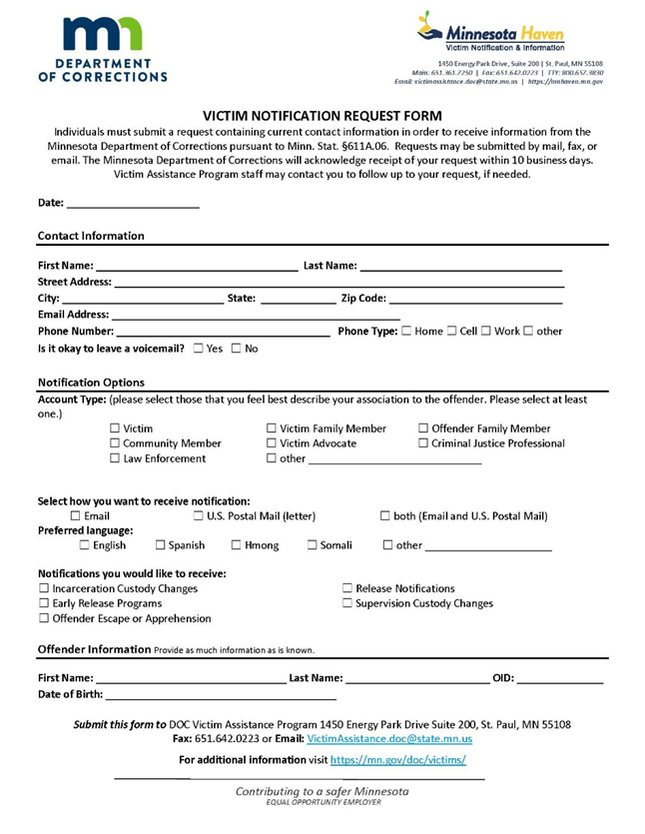
Minnesota Haven
A web-based solution that is customized for victim notification, a resource for information on victim and community safety, and empowers victims and communities to provide input and request information based on their individual needs.
Notes:
Minnesota Haven, is the DOC’s web-based notification and case management system.

Slide 10
Collaboration questions
Q: how does an advocate get them outside resources? What is the process?
**Role of advocacy in facility – legal calls? Legal meetings? – access to materials; mail and books. Can we mirror advocacy services as we do with access to religious services?
**Navigating confidentiality --- ROI (sign prior to incarceration if possible) to allow contact victim services – reach out to VS to let them know individual is coming.

Slide 11
Prosecution
Support
IP’s family and caregivers
Advocates
Legal Support
Child Issues

Slide 12
Supervision violation hearings
Support
Legal Support

Slide 13
Incarceration
Support
IP’s family and caregivers
Advocates
Trauma
Healthy relationships
Trauma based behaviors – facility staff, treatment, roommates, etc.
New traumas and triggers due to incarceration
Coping
Lack of control
New coping mechanisms
Mental health
Depression, anxiety, PTSD
Legal Support
Child Issues
Staying connected
Navigating parenting time / court directed contact
Facility programs around child contact/involvement (parenting, RIF, etc.)
CPS

Slide 14
Supervision
Accessing services on supervision
Importance of continued support and positive connections within the community to assist in addressing healthy choices, relapse, life stressors, job security, etc.
Support a good working relationship with supervising agent
Housing opportunities and stability
Job opportunities – continuing vocational training (heavy equipment certification, etc.)
Treatment and support groups
Access to mental and medical health
Depression, anxiety, PTSD
Education opportunities – continuing education
Child Issues
Including parenting time in supervision plan
CPS requirements – reestablish relationships

Slide 15
Abuser is justice involved
IP’s abuser is also justice involved
Safety issues
Access to information
Healthy boundaries

Slide 16
Questions?

Slide 17
Thank you!
Brittany Anderson
Victim Services Coordinator
Brittany.Anderson@state.mn.us
(651) 361-7113
Laurissa Wredberg
Victim Advocate
Laurissa.Wredberg@state.mn.us
(651) 318-9008

